Slide 1
Fundamentals of Computer Science
Part i2
Lecture 5
Machine Code

Slide 2
Topics for this lecture
Simple machine language
Typical instructions
  transfer from/to memory
  arithmetic
  transfer of control
A microprogrammed interpreter
More machine language features
  addressing modes

Slide 3
Machine code
Microprogramming
  too low-level, very tedious
Machine language
  assumes accumulator ACC (special register)
  provides simple instructions, e.g.
    LOAD cell 32 into accumulator ACC
  each instruction
    coded as a bit string and stored in main memory
    interpreted via a microprogram, e.g.
    0+32 -> MAR; read; MDR -> ACC

Slide 4
Representing an instruction
1 2 3 4 5 6 7 8 9 10 11 12 13 14 15 16
Opcode
4 bits
Memory address
12 bits
For example
  LOAD cell 32 into accumulator ACC
represented as 16 bit string (not 22 signals):
0
0
0
1
0
0
0
0
0
0
1
0
0
0
0
0

Slide 5
Instruction groups
Transfer between memory and accumulator
  LOAD into ACC, STORE in memory
Arithmetic
  ADD, SUBTRACT, MULTIPLY, DIV
  arguments in memory and ACC, result in ACC
Transfer of control
  JUMP to a specified memory address which contains instruction
  JUMPSUB/RETURN to/from procedure (subroutine)

Slide 6
Transfer between memory and ACC
LOAD M
  M is treated as memory address
  contents of location M moved to ACC
STORE M
  moves contents of ACC into location with address M
Note: if you want to transfer the value 152 into ACC, you must place it in memory in a known location...

Slide 7
Arithmetic
For simplicity assume only positive numbers and zero
ADD M
  M is treated as memory address
  adds contents of location M to ACC
  if result too large (e.g. 65535+1) set overflow flag
SUBTRACT M
  as above, except subtract contents of location M from ACC
MULTIPLY M, DIV M
  similar to addition/subtraction

Slide 8
Example
Calculate how many seconds there are in x hours
  100: LOAD 200 7 -> ACC
  101: MULT 202 ACC*60 -> ACC
  102: MULT 202 ACC*60 -> ACC
  103: STORE 201 ACC -> cell 201 (result)
  ………
  200: 7 x, number of hours
  201: space for result
  202: 60 multiplier
start

Slide 9
Transfer of control
JUMP M
  M treated as address of instruction
  jump to memory cell M
JUMPZERO M
  jump to memory cell M if ACC is zero
JUMPMSB M
  jump to memory cell M if most significant bit of ACC is set
  used to test if ACC contains a negative number

Slide 10
Example: calculate 2^{x}
  100: LOAD 112
  101: STORE 111 1 -> cell 111
  102: LOAD 110 x -> ACC
  103: JUMPZERO 113 if x=0, finished
  104: SUBTRACT 112
  105: STORE 110 x-1 -> x
  106: LOAD 111
  107: ADD 111
  108: STORE 111 double y
  109: JUMP 102
  110: 3 x initially
  111: y, finally the result
  112: 1 the value 1
  113: ... continue...

Slide 11
Points to note...
Machine code instructions
  stored in main memory
  indistinguishable from data - simply bit strings
Potential for serious errors...
  e.g. what if change to JUMPZERO 110 ?
  executes instruction with opcode 0000 and address 3
  what if change to 100: LOAD 102 ?
  what is loaded into ACC ?
But also for flexibility!
  programmer can generate/modify instructions

Slide 12
What about methods?
Methods can be invoked (called) from other objects
Need call a procedure (subroutine) and return from a procedure
Must be able to tell which caller to return to: stores return address in first cell
Main
Method
JUMPSUB
next instr.
Address cell
Instructions
RETURN

Slide 13
Calling subroutine
  Before JUMPSUB After JUMPSUB
  100: ... 100: ...
  101: executing here 101: ...
  102: JUMPSUB 302 102: JUMPSUB 302
  103: ... 103: ...
  104: ... 104: ...
  ...: ... ...: ...
  302: reserved cell 302: 103
  303: ... 303: executing here
  304: ... 304: ...
  305: RETURN 302 305: RETURN 302

Slide 14
Returning from subroutine
  Before RETURN After RETURN
  100: ... 100: ...
  101: … 101: ...
  102: JUMPSUB 302 102: JUMPSUB 302
  103: ... 103: executing here
  104: ... 104: ...
  ...: ... ...: ...
  302: 103 302: 103
  303: ... 303: ...
  304: executing here 304: ...
  305: RETURN 302 305: RETURN 302

Slide 15
A microprogrammed interpreter
Implements machine code
  on top of our microprogrammed computer
  as a microprogram in Micromemory
Uses
  register A as accumulator ACC
  register B as PC (Program Counter, similar to MPC)
Set B to address of first instruction, & repeatedly
  fetch next instruction into MDR; increment B
  decode the instruction
  execute the instruction

Slide 16
Microprogram for interpreter
0: B+0 -> MAR, read; MPC+1 -> MPC Fetch instr. to MDR
1: B+1 -> B; MPC+4bitsMDR -> MPC Increment B
Decode instruction
2: 13 -> MPC LOAD (opcode 1)
3: 15 -> MPC STORE (opcode 2)
...
13: 0+MDR -> MAR, read; MPC+1 -> MPC Execute LOAD
14: 0+MDR -> A; 0+0 -> MPC Back to start (fetch)
15: … Execute STORE
... ...
55: 0+MDR -> B; 0+0 -> MPC Execute JUMP
Back to start (fetch)

Slide 17
More machine code features
Currently arguments in ACC and memory
  too restrictive
  tedious (need place constant values in memory)
Often can specify register as an argument
  allocate k bits in instruction, 2^{k} registers
Variety of addressing modes, needed for
  constants immediate
  pointers indirect
  array elements indexed

Slide 18
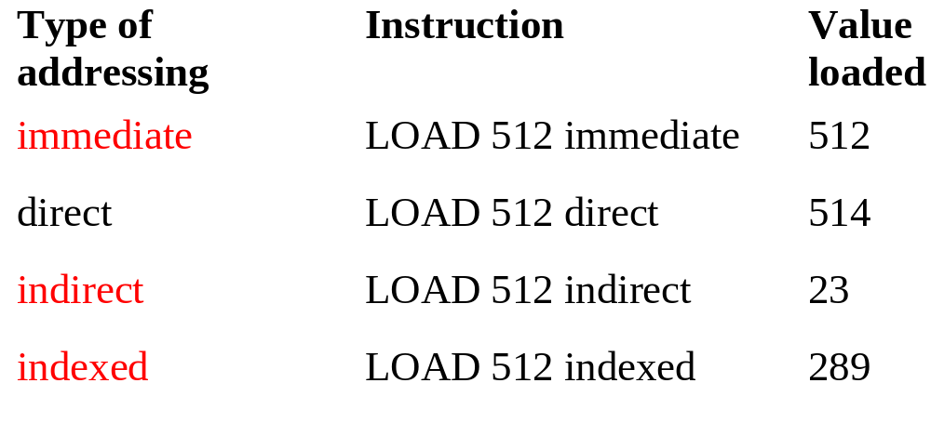
Addressing Modes
Index register
512 514
513 17
514 23
515 289 512+3
3

Slide 19
Summary
Machine code
  often microprogrammed for flexibility
  low-level and error prone
  used for efficiency reasons
Complex Instruction Set Computer (CISC)
  more complex microprogrammed interpreter
  slower execution time, more power per instruction
Reduced Instruction Set Computer (RISC)
  small set of simpler instructions, faster execution time
  common, but hampered by upward compatibility

